Slide 1
June 2017
The second River Basin Management Plans and implementation of fish barriers measures
Jenny Davies
RBMP coordinator

Slide 2
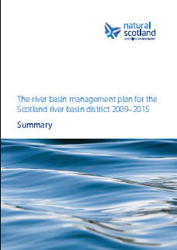
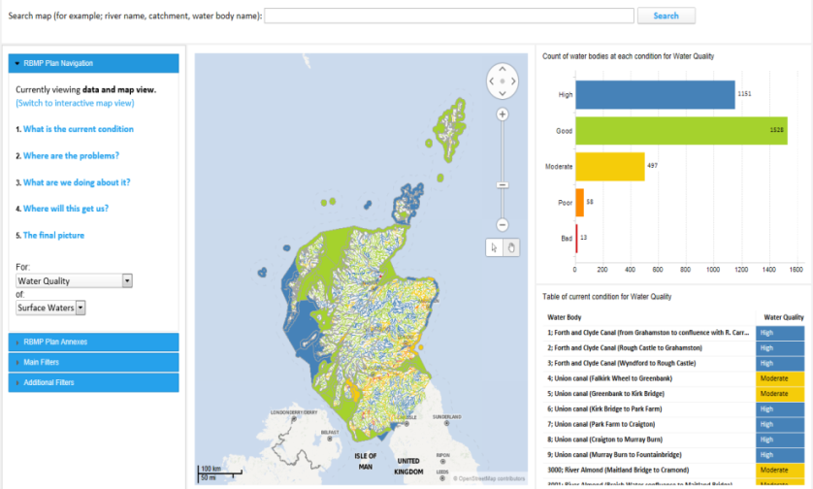
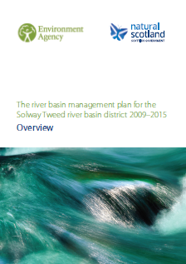
Scotland’s River Basin Plans
Current state (classification)
Impacts (pressures)
Actions (measures)
Outcomes (summary of objectives)

Slide 3
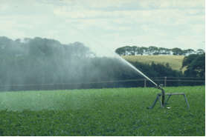
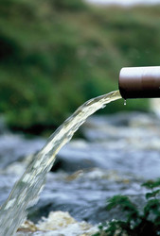
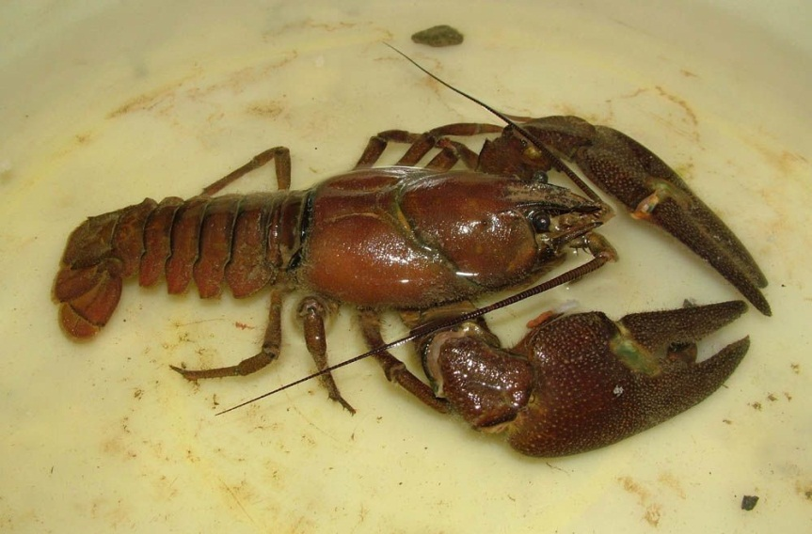
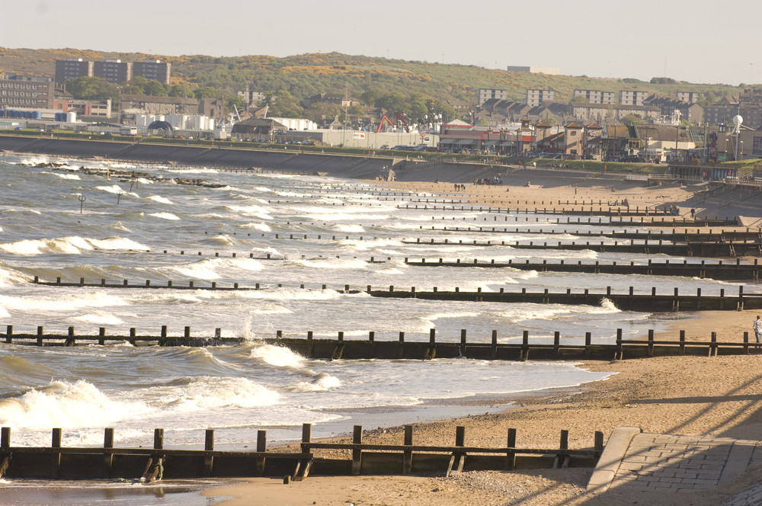
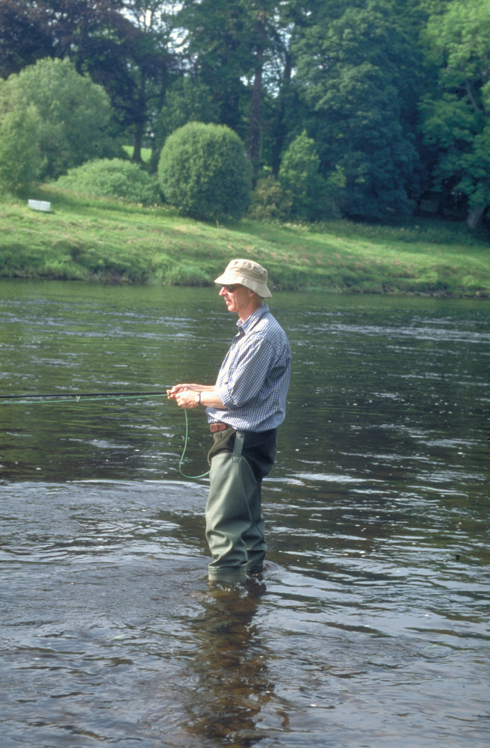
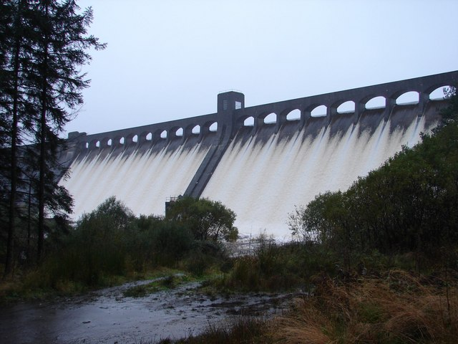
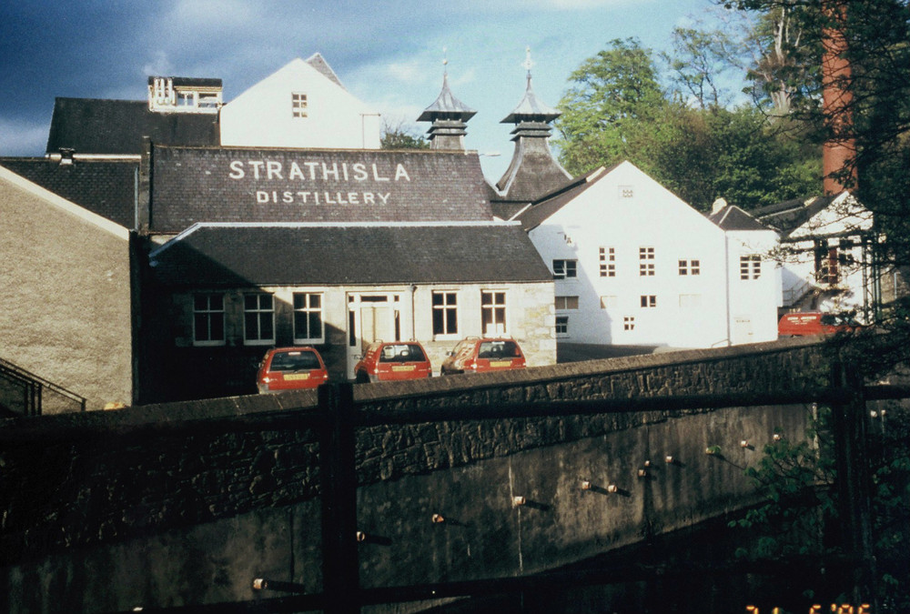
Notes:
1. SEPA produces river basin plans on behalf of Scotland.
2. The Minister will sign off Second Plans - and they are branded as Natural Scotland documents
3. The plans set out benefits to the environment, society and economy that is a balanced view for Scotland.
4. Scottish Ministers ultimately are responsible for delivery of plans – including making sufficient resources available. SEPA at the sharp end of this – we need to ensure whatever resource is made available to us, is prioritised according to the plans.

Slide 4
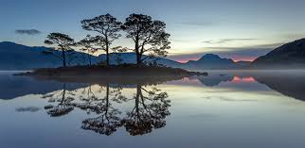
Scotland is famous for its water environment
FORESTRY AND DIFFUSE POLLUTION
Improve fish passage and associated ecology.
Social benefits - people are drawn to water for recreation, leisure and spiritual reasons.
Economically important for tourism.
Jackie McColm
SEPA
Notes:
Iterating the importance of the water environment.

Slide 5
Objectives and state of the water environment in Scotland
HIGH
No deterioration
Improve to Good Status by 2027
Protected Areas
GOOD
MODERATE
R e s t o r e
POOR
BAD
Notes:
RBMPs has two main types of objectives.
First is to protect against deterioration in quality – through authorising new activities, land use planning decisions and protecting against the spread of invasive.
Second is to improve to good status by 2027 - Ambitious plan – We need to do this unless there is a very good reason not to.
The plans also cover protected areas – bathing waters, drinking water, shellfish waters and conservation areas.
5. Objective setting has been lead by the Water unit supported by SEPA sector leads and informed by
external sector engagement
consultation feedback
ecosystems services data
PA status (SAC, SPA, NVZ, UWWTD etc)
confidence of classification and pressures
estimated costs of improvement versus the ££ available (done through scenarios and impacts on use)

Slide 6
Key Pressures on the Water Environment (Scotland RBD)
4000km of river habitat inaccessible to fish and eels.
No. of water bodies
Notes:
Figures for Scotland RBD showing what pressures are affecting the 35% of wbs less than good status.
One wb may have one or more of these pressures affecting it.
.

Slide 7
Highland

Slide 8
Moray

Slide 9
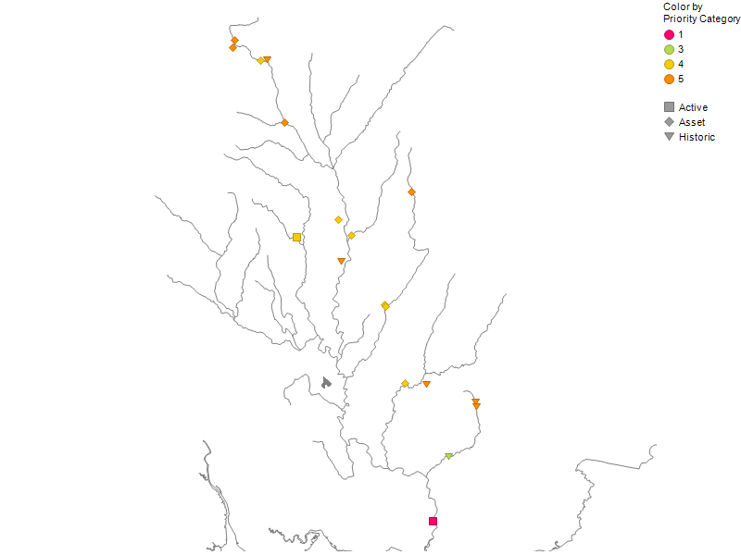
Catchment approach
Notes:
Catchment approach provides an example of the complexity of fish barrier work.
There is a mix of 2021 and 2027 objectives but mainly a mixed of type of barrier and sectors.
Up North our catchments tend to be smaller and less complex so some of out barriers are the only issue.

Slide 10
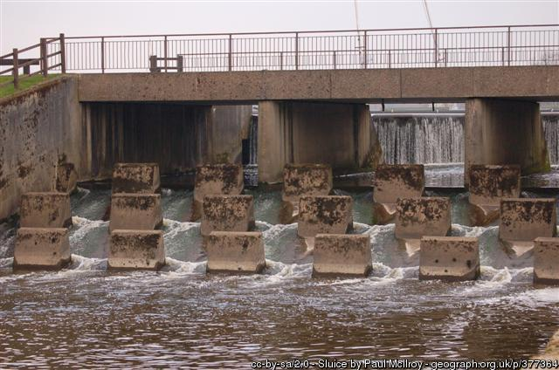
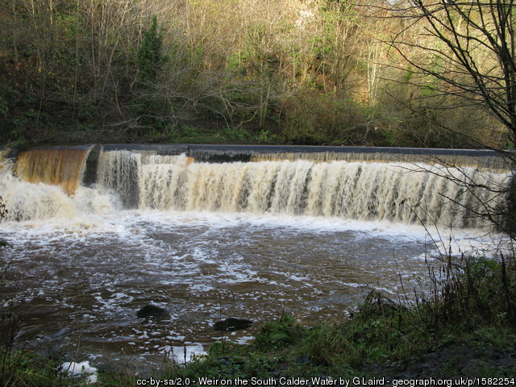
Categories of Fish Barriers
Active barrier
Active Barrier – an impoundment, weir or dam that is a barrier to fish movement and is being operated or maintained (or is planned to be operated or maintained); or, it is a mothballed weir, impoundment or dam (i.e. it is not currently operated or maintained but the owners operate/maintain similar structures for the purposes of their business). Regulatory approach by sector – Hydropower is the priority for this cycle.
Historic Barrier - an impoundment, weir or dam constructed prior to 1 April 2006 that is a barrier to fish movement and is not operated or maintained. Nor is it owned by a business who operates or maintains similar structures for the purposes of their business. Funded by Scottish Government via the Water Environment Fund, WEF.
Asset Barrier – a culvert or bridge apron built prior to 1 April 2006 that is a barrier to fish movement. Working with Responsible Authorities.
Historic Barrier
Asset Barrier

Slide 12
Notes:
Overall, asset barrier represents less than third of the barriers with a second cycle objective. However, it is a new area of work that will require a lot of engagement with the sector.
The transport sector is the dominant sector for asset barrier- this is also true for the third cycle.

Slide 13
Action on fish migration
Remove/ ease 184 barriers by 2021 and a further 189 by 2027
Prioritised based on quantity of habitat and catchments
Significant benefits to fish populations, opening up large amounts of new habitat

Slide 14
Responsible Authorities
Water Environment Water Services Act 2003
Section 2: The responsible authorities must exercise their designated functions so as to secure compliance with the requirements of the Directive
identified by Scottish Ministers
work in partnership with SEPA to develop and implement river basin planning
adopt an integrated approach to co-ordinate our respective functions that affect the water environment.
Currently these are:
• Local Authorities
• Scottish Water
• Scottish Natural Heritage
• Forestry Commission Scotland
• British Waterways-Scottish Canals
• National Parks Authority

Slide 15
Summary
Fish barrier is the major pressure on the water environment
Easement and removal of fish barriers is a priority for Scotland
Partnership is key to achieve these objectives

