Slide 1

June 2017
Addressing fish barriers
Eilidh Johnston
RBMP coordinator

Slide 2
Initial process on fish barriers
Identify fish barrier
Prioritise for action
Scope

Slide 3
Agree if impassable, feasible and proportionate
Design and build
Monitor and reclassify

Slide 4
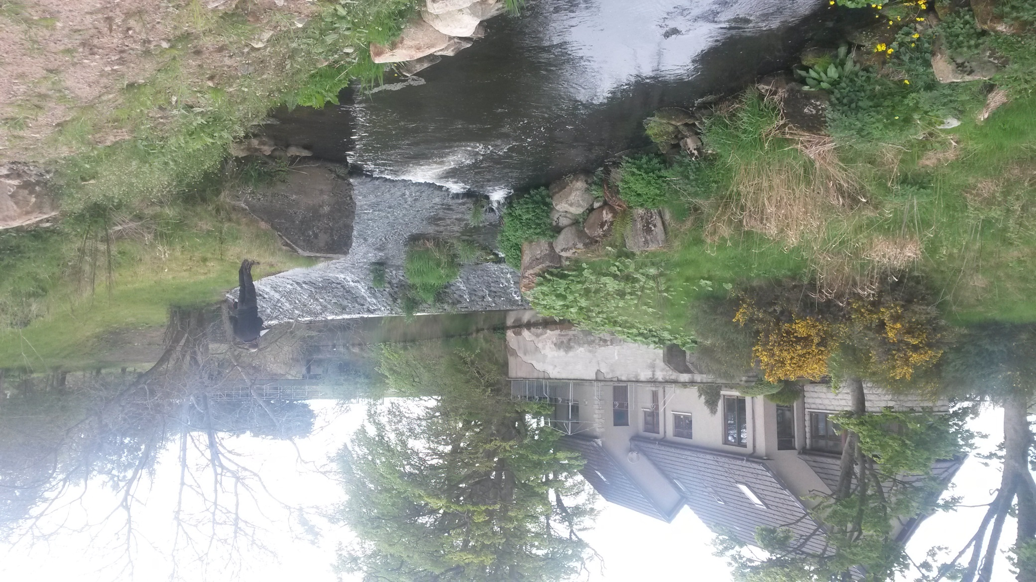
Scoping a barrier
Notes:
History, ownership and current use
Engagement with interested parties
Environmental impact
Logistics
Costs and benefits

Slide 5
Other assessment
Other assessment
Flooding
Conservation area
Ownership
Costs & benefits
External engagement
Services
Access

Slide 6
Options development, design and build
Options development and design can be in-house or by consultants.
Should consider impacts on fish passability, flows and sediment.

