Slide 1
November 2017
River Basin Management Planning
Jenny Davies
RBMP coordinator

Slide 2
Scotland's greatest asset?
FORESTRY AND DIFFUSE POLLUTION
Environmental reputation is key for Scotland
Social benefits - people are drawn to water for recreation, leisure and spiritual reasons.
Economically important for business including food production, hydro, tourism etc
Jackie McColm
SEPA

Slide 3
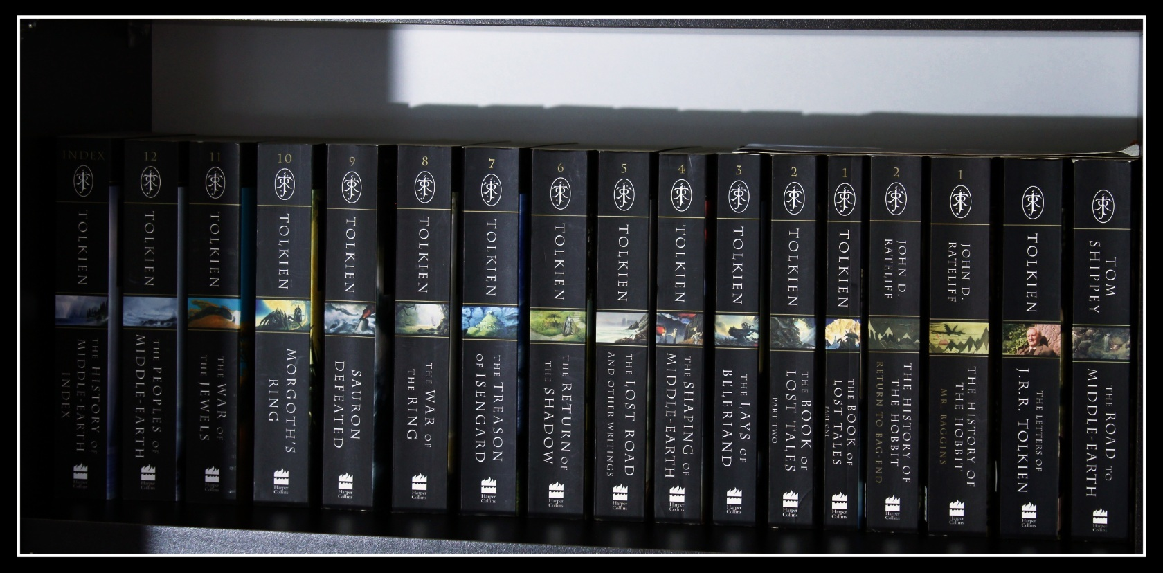
History of RBMP
Engagement started with stakeholders 2004
First advisory groups established 200?
Various consultations then published the first plans in 2009 – it was big!
Cycle 1 – 11 advisory groups established but no delivery framework and conflicting interests. They did contribute significantly to development though.
Second plan development we have listened and changed the way we work hopefully to better understand pressures and deliver projects.

Slide 4
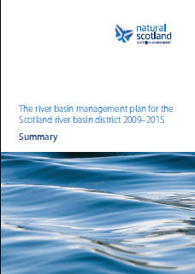
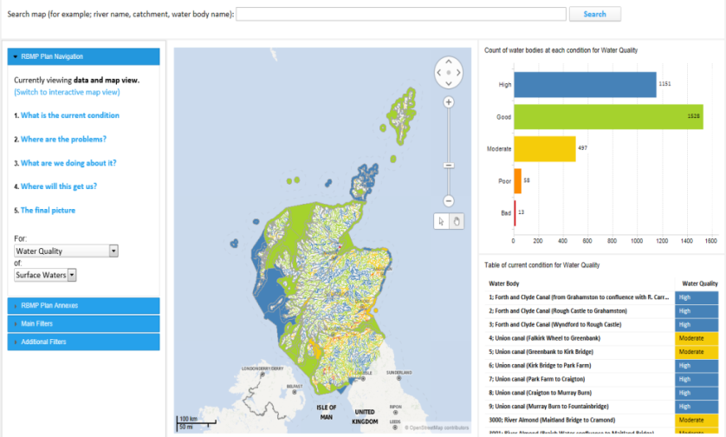
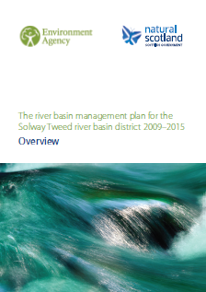
Scotland’s Second River Basin Plans
Current state (classification)
Impacts (pressures)
Actions (measures)
Outcomes (summary of objectives)

Slide 5
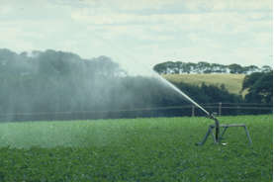
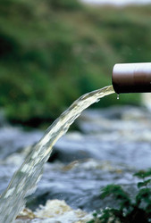
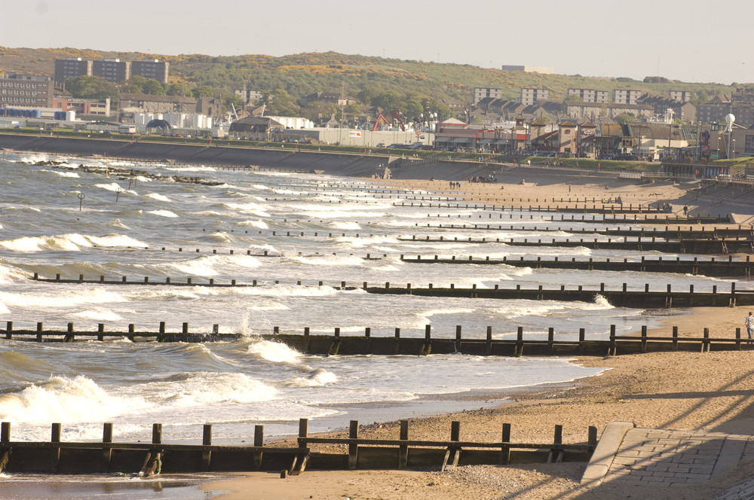
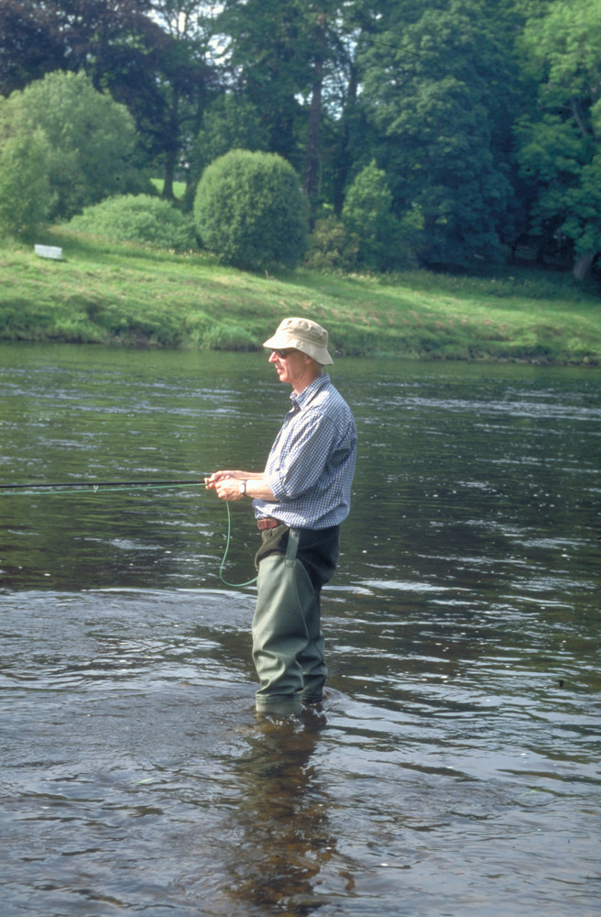
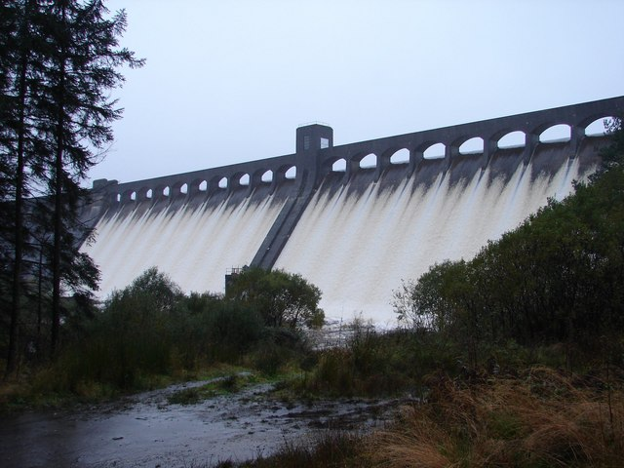
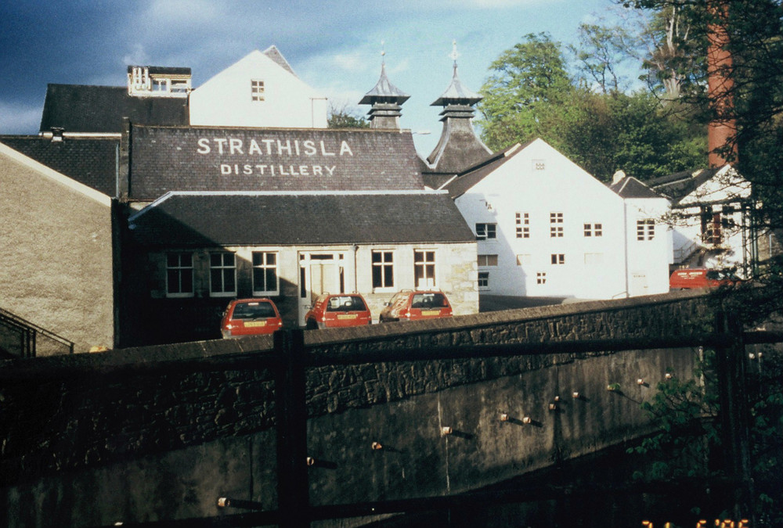

Slide 6
Condition of Water Bodies in 2014

Slide 9
How will this be delivered ?
Scotland’s plan, not just SEPA!
Catchment working
Increased delivery role for Responsible Authorities
Develop new delivery frameworks and expand existing ones
More tools… remedial measure notices, fixed monetary penalties etc

Slide 10
Engagement with partners
AAG forum extended to a wider network
No longer hold formal meetings
Focus on delivery partnerships/ project focus
Multiple benefits and efficiencies in delivery are key drivers – the catchment based approach helps this.
Align engagement and delivery with other workstreams such as Flood Risk Management and Diffuse Pollution

Slide 11
Today is about working better with you – aligning our priorities.
We want to be sure we target our efforts where there is real environmental harm
Our monitoring programme informs classification but we can’t monitor everything.
Classification determines the pressures without which we can’t set measures and objectives.
Effectively without classification downgrades there is no pressure – no pressure means no measure or objective so no £££ and no resource.

