Slide 1

November 2017
The second River Basin Management Plans and implementation of fish barriers measures
Jenny Davies
RBMP coordinator

Slide 2
Key Pressures on the Water Environment (Scotland RBD)
4000km of river habitat inaccessible to fish and eels.
No. of water bodies

Slide 3
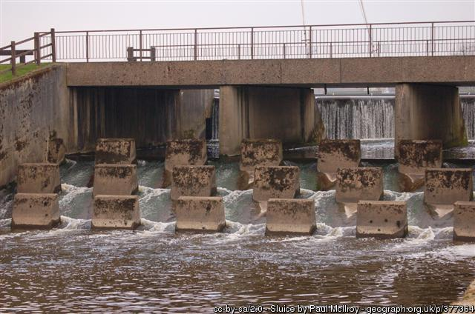
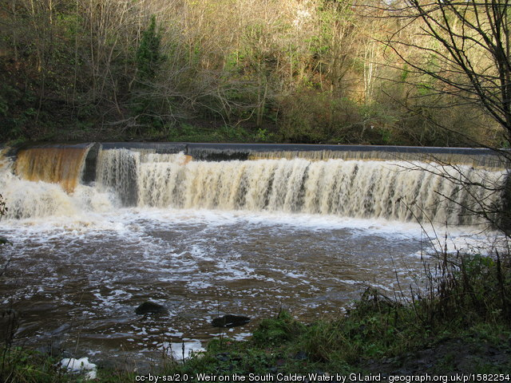
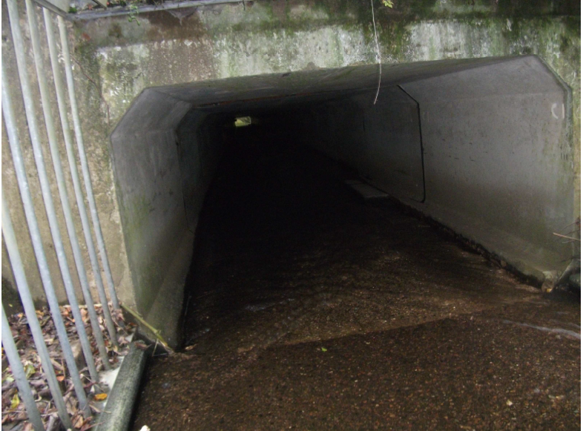
Categories of Fish Barriers
Active barrier
Active Barrier – an impoundment, weir or dam that is a barrier to fish movement and is being operated or maintained (or is planned to be operated or maintained); or, it is a mothballed weir, impoundment or dam (i.e. it is not currently operated or maintained but the owners operate/maintain similar structures for the purposes of their business). Regulatory approach by sector – Hydropower is the priority for this cycle.
Historic Barrier - an impoundment, weir or dam constructed prior to 1 April 2006 that is a barrier to fish movement and is not operated or maintained. Nor is it owned by a business who operates or maintains similar structures for the purposes of their business. Funded by Scottish Government via the Water Environment Fund, WEF.
Asset Barrier – a culvert or bridge apron built prior to 1 April 2006 that is a barrier to fish movement. Working with Responsible Authorities.
Historic Barrier
Asset Barrier

Slide 5
Action on fish migration
Scope all barriers by 2021 – currently underway
Remove/ ease 184 barriers by 2021 and a further 189 by 2027
Prioritised based on quantity of habitat and catchments
Significant benefits to fish populations, opening up large amounts of new habitat

Slide 6
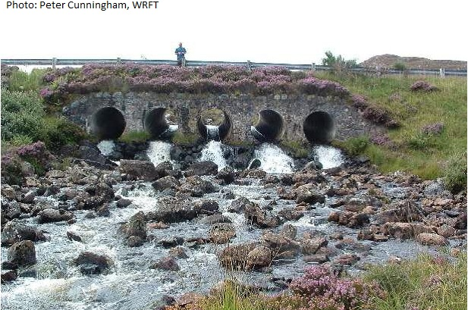
Scoping a barrier

Slide 7
Other assessment
Other assessment
Flooding
Conservation area
Ownership
Costs & benefits
External engagement
Services
Access

Slide 8
Following scoping
Agree if impassable, feasible and proportionate
Design and build
Monitor and reclassify

Slide 9

Summary
Fish barrier is the major pressure on the water environment
Easement and removal of fish barriers is a priority for Scotland
Partnership is key to achieve these objectives

